Slide 1


Shamir Ragoonanan
January 2026

Slide 2

Outline
Executive Summary
Introduction
Methodology
Results
Conclusion
Appendix

Slide 3
Executive Summary
The goal of this project is to predict whether the SpaceX Falcon 9 first-stage booster will successfully land after launch.
Data was collected from the SpaceX REST API and Wikipedia using web scraping techniques. After data wrangling and exploratory data analysis (EDA), patterns related to payload mass, orbit type, launch site, and mission year were identified.
Interactive visual analytics were built using Folium and Plotly Dash to explore geographic and performance trends. Several classification models were trained and evaluated, including Logistic Regression, SVM, Decision Tree, and KNN.
The final model achieved strong predictive performance, demonstrating that payload mass and orbit type are key factors influencing landing success. These findings highlight how booster reusability contributes to cost reduction and operational efficiency. Logistic Regression, SVM, and KNN achieved the highest accuracy (~83%)

Slide 4
Introduction
Project Background and Context
SpaceX reduces launch costs by reusing Falcon 9 first-stage boosters.
Successful landings are critical to determining launch cost efficiency.
Problem Statement
Can we predict whether a Falcon 9 booster will land successfully?
Objectives
Collect and clean SpaceX launch data
Identify factors influencing landing success
Build and evaluate classification models

Slide 5

Section 1

Slide 6
Methodology
Data collection
Data wrangling
EDA
Interactive analytics
Predictive modeling

Slide 7
Data Collection
Data was collected from two primary sources:
SpaceX REST API
Wikipedia Falcon 9 launch records
Python libraries used:
requests, pandas, BeautifulSoup
Raw data was transformed into structured tabular format for analysis

Slide 8
Data Collection – SpaceX API
Initiate API Request
(requests.get to SpaceX API)
Fetch Launch Data
(dates, sites, payloads, outcomes)
Parse JSON Response
(response.json())
Extract Relevant Fields
(date, site, payload mass, orbit, landing outcome)
Store Data in DataFrame
(pandas DataFrame)
Save Data Locally
(CSV file / database)
SpaceX REST API was used to retrieve launch, rocket, payload, and landing outcome data
API calls were made using HTTP requests
JSON responses were normalized into Pandas DataFrames
Github URL: https://github.com/shamir-ragoonanan/spacex-launch-prediction

Slide 9
Data Collection - Scraping
Request Web Page requests.get Wikipedia URL
Parse HTML Content BeautifulSoup
Extract Launch Records HTML table
Convert Table to DataFrame pandas DataFrame
Clean and Format Data Drop nulls, standardize columns
Wikipedia was scraped to obtain historical Falcon 9 launch data
Tables were extracted using BeautifulSoup and Pandas
Scraped data was merged with API data
Github URL: https://github.com/shamir-ragoonanan/spacex-launch-prediction

Slide 10
Data Wrangling
Missing values were handled and cleaned
Categorical variables were encoded
Only Falcon 9 launches were retained
A binary target variable (LandingOutcome) was created
Missing values were handled and cleaned
Falcon 9 launches were filtered
Categorical variables were encoded
A binary target variable (LandingOutcome) was created

Slide 11
EDA with Data Visualization
• Bar charts were used to analyze the relationship between launch site, orbit type, and landing success
• Scatter plots were used to examine the impact of payload mass on landing outcome
• Line plots were used to observe launch trends over time
• These visualizations helped identify patterns and correlations influencing Falcon 9 landing success
• Github URL: https://github.com/shamir-ragoonanan/spacex-launch-prediction

Slide 12
EDA with SQL
• SQL queries were used to explore launch data by grouping and aggregating key variables such as launch site, orbit type, and landing outcome
• Aggregate functions (COUNT, SUM, AVG) were applied to analyze success rates and payload distributions
• Filtering and ordering queries were used to compare Falcon 9 launch performance across different conditions
• SQL analysis helped validate patterns observed during visual exploratory data analysis
• Github URL: https://github.com/shamir-ragoonanan/spacex-launch-prediction

Slide 13
Build an Interactive Map with Folium
• An interactive Folium map was created to visualize SpaceX launch sites and landing outcomes
• Markers were added to represent launch site locations with popups displaying site names and coordinates
• Circle markers were used to indicate launch success and failure using color and size for visual distinction
• Distance lines were added to show proximity between launch sites and nearby geographical features
• These map objects helped provide spatial insight into launch site locations and landing performance
• Github URL: https://github.com/shamir-ragoonanan/spacex-launch-prediction

Slide 14
Build a Dashboard with Plotly Dash
• An interactive dashboard was built using Plotly Dash to explore Falcon 9 launch and landing data
• The dashboard includes bar charts showing launch success by site and orbit type
• Scatter plots were added to analyze the relationship between payload mass and landing outcome
• Dropdown menus and range sliders were implemented to allow user-driven filtering and interaction
• These interactive components enable dynamic exploration of factors affecting Falcon 9 landing success
• Github URL: https://github.com/shamir-ragoonanan/spacex-launch-prediction

Slide 15
Predictive Analysis (Classification)
Prepare Dataset Feature selection and scaling
Split Data Training and testing sets
Train Classification Models LR, SVM, DT, KNN
Tune Hyperparameters Cross-validation
Evaluate Models Accuracy and confusion matrix
Select Best Model Highest performance
• Multiple classification models were developed to predict Falcon 9 landing success
• The dataset was split into training and testing sets to evaluate model performance
• Logistic Regression, Support Vector Machine, Decision Tree, and K-Nearest Neighbors models were trained
• Hyperparameter tuning and cross-validation were applied to improve model performance
• Model accuracy and confusion matrices were used to identify the best performing classifier
• Github URL: https://github.com/shamir-ragoonanan/spacex-launch-prediction

Slide 16
Results
• Exploratory data analysis revealed strong relationships between launch site, orbit type, payload mass, and Falcon 9 landing success
• Interactive analytics using Folium maps and Plotly Dash dashboards provided spatial and dynamic insights into launch performance
• Predictive classification models demonstrated that landing outcomes can be accurately predicted using engineered features and machine learning techniques

Slide 17

Section 2

Slide 18
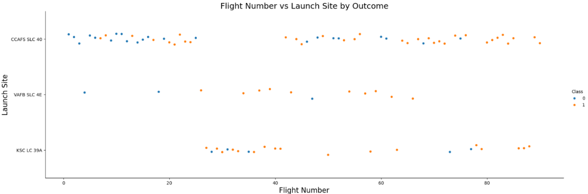
Flight Number vs. Launch Site
• Each point represents a Falcon 9 launch, plotted by flight number and launch site
• Early launches show a higher frequency of unsuccessful landings across sites
• Landing success becomes more consistent as flight numbers increase
• This trend suggests improved launch and landing reliability over time

Slide 19
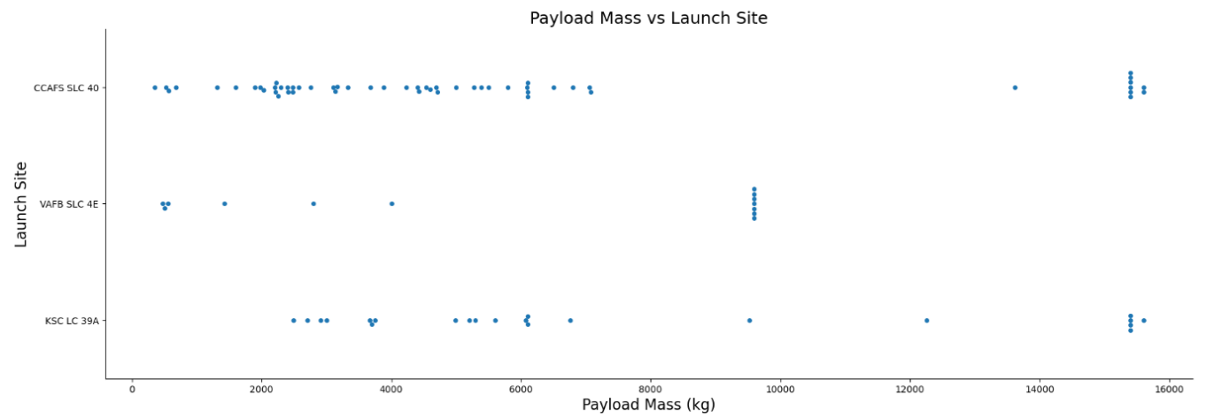
Payload vs. Launch Site
Each point represents a Falcon 9 launch plotted by payload mass and launch site
Lower payload masses show a higher frequency of successful landings across all launch sites
Higher payload missions are more concentrated at specific launch sites
This suggests that both payload mass and launch site play an important role in Falcon 9 landing success

Slide 20
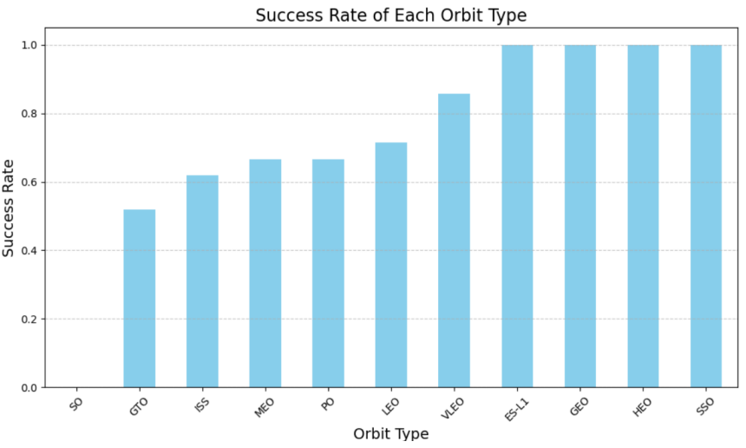
Success Rate vs. Orbit Type
Each bar represents the Falcon 9 landing success rate for a specific orbit type
Higher success rates are observed for orbits such as LEO and ISS, indicating more reliable landing outcomes
Lower success rates are seen for certain high-energy orbits, such as GTO, where landing conditions are more challenging
This suggests that orbit type significantly influences Falcon 9 landing success, likely due to differences in mission energy requirements and recovery constraints

Slide 21
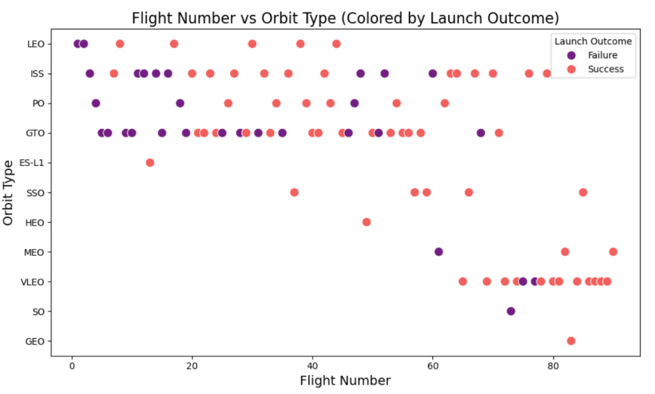
Flight Number vs. Orbit Type
Each point represents a Falcon 9 launch, plotted by flight number and orbit type
Early missions are concentrated in fewer orbit types, reflecting SpaceX’s initial operational focus
As flight numbers increase, launches expand across a wider variety of orbit types
Successful landings become more frequent in later flights across multiple orbit types
This trend indicates increasing mission complexity and improved Falcon 9 reliability over time

Slide 22
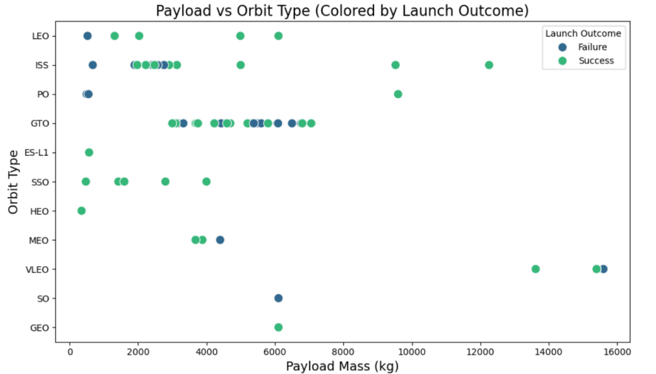
Payload vs. Orbit Type
Each point represents a Falcon 9 launch, plotted by payload mass and orbit type
Lower payload masses are more common for LEO and ISS missions, where landing success rates are generally higher
Higher payload masses are associated with more energy-intensive orbits such as GTO and GEO
Successful landings occur more frequently at lower payload masses across most orbit types
This indicates that both payload mass and orbit type significantly influence Falcon 9 landing success

Slide 23
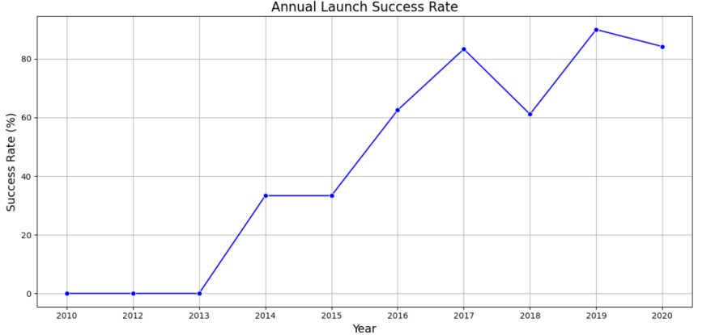
Launch Success Yearly Trend
The line chart shows the yearly average Falcon 9 landing success rate
Early years exhibit lower and more variable success rates, reflecting initial development and testing phases
A clear upward trend is observed over time, indicating continuous improvement in landing performance
In later years, success rates approach near consistency, demonstrating increased reliability and operational maturity
This trend highlights SpaceX’s learning curve and the effectiveness of iterative design and recovery improvements

Slide 24
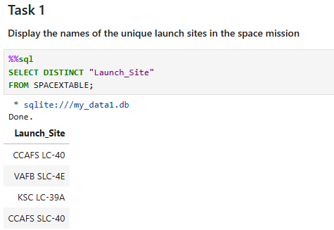
All Launch Site Names
The SQL query was used to retrieve the unique launch site names from the dataset
The following three launch sites were identified:
CCAFS LC-40 (Cape Canaveral Air Force Station, Florida)
KSC LC-39A (Kennedy Space Center, Florida)
VAFB SLC-4E (Vandenberg Air Force Base, California)
These launch sites represent SpaceX’s primary locations and were used in subsequent analyses to evaluate landing success patterns across different geographic sites
Although CCAFS LC-40 appears twice in the raw query output due to naming inconsistencies, it represents the same launch site and was counted once when identifying unique launch locations.

Slide 25
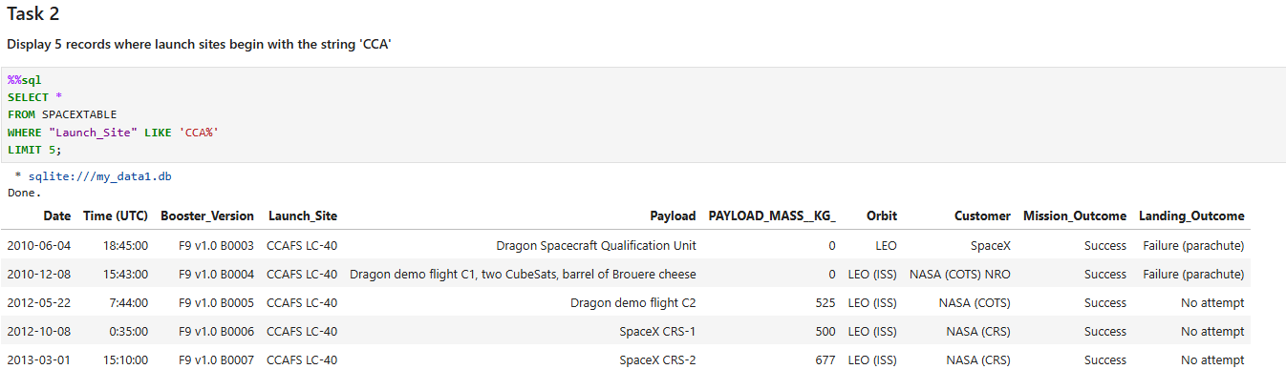
Launch Site Names Begin with 'CCA'
The SQL query filters the dataset to return records where the launch site name begins with “CCA”, corresponding to Cape Canaveral Air Force Station launches.
Five sample records were retrieved to demonstrate missions launched from this site.
This confirms that CCAFS LC-40 is one of SpaceX’s most frequently used launch locations.

Slide 26
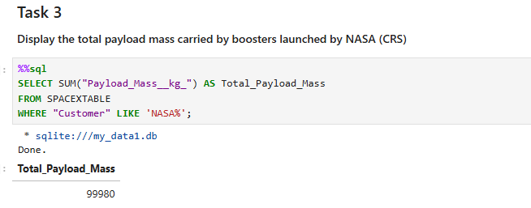
Total Payload Mass
The SQL query calculates the total payload mass carried by Falcon 9 boosters for NASA missions.
By filtering records where the customer is NASA and summing the payload mass, we obtain the cumulative payload delivered across all NASA-related launches.
This result highlights the significant role Falcon 9 plays in supporting NASA missions, including cargo resupply and scientific payload delivery to orbit.

Slide 27
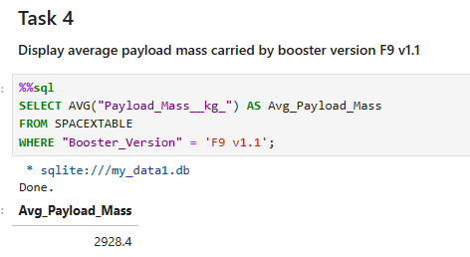
Average Payload Mass by F9 v1.1
The SQL query calculates the average payload mass carried by Falcon 9 booster version F9 v1.1.
By filtering launches specific to this booster version and computing the average payload mass, we obtain an estimate of its typical payload capacity.
The result shows that F9 v1.1 carried an average payload of approximately 2,928 kg, reflecting its performance during early operational missions.
This provides insight into the payload capabilities of Falcon 9 before later performance upgrades in subsequent versions.

Slide 28
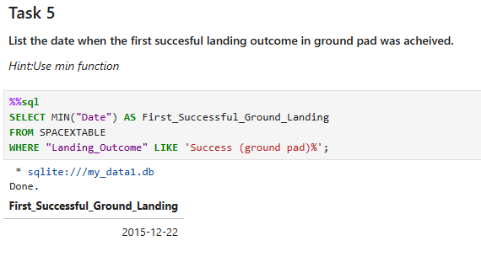
First Successful Ground Landing Date
The SQL query filters launch records to identify missions where the landing outcome was a successful ground pad landing.
By ordering the results chronologically and selecting the earliest date, we determine the first time Falcon 9 successfully landed on a ground-based landing zone.
The query result shows that the first successful ground landing occurred on December 22, 2015.
This mission marked a historic milestone for SpaceX, demonstrating the feasibility of reusable orbital-class rocket boosters and significantly advancing cost-efficient spaceflight.

Slide 29
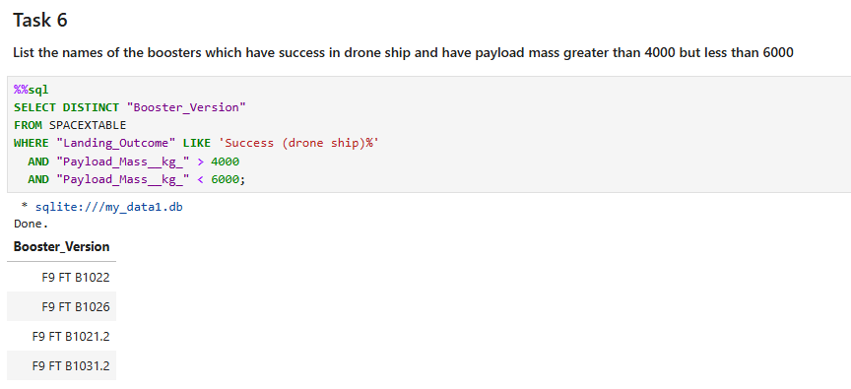
Successful Drone Ship Landing with Payload between 4000 and 6000
The SQL query filters launch records to identify missions where Falcon 9 boosters successfully landed on a drone ship.
Payload mass constraints were applied to include only missions carrying payloads between 4,000 kg and 6,000 kg.
The resulting booster versions represent Falcon 9 boosters capable of successful drone ship recovery under moderate payload conditions, demonstrating operational reliability in more demanding missions.

Slide 30
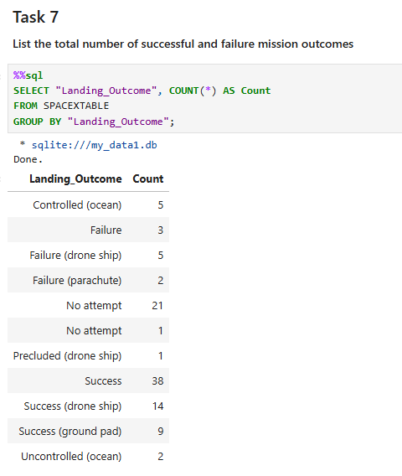
Total Number of Successful and Failure Mission Outcomes
The SQL query groups launch records by landing outcome to calculate the total number of successful and failed landing attempts.
By counting each landing outcome category, we obtain an overall distribution of Falcon 9 booster recovery results.
The results show that successful landings significantly outnumber failures, reflecting the increasing reliability of Falcon 9 recovery operations over time.
This summary provides a high-level overview of landing performance and supports further analysis of recovery success trends.

Slide 31
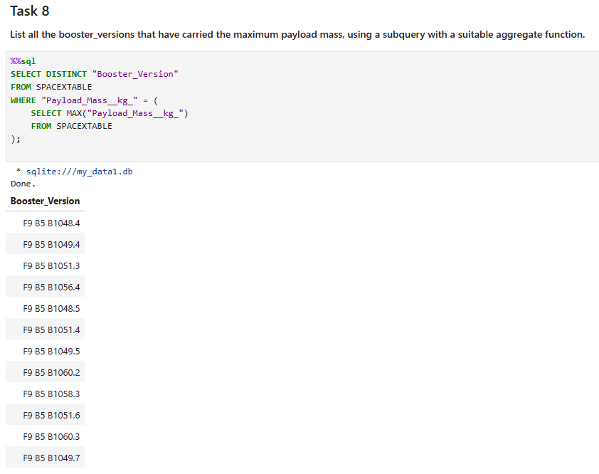
Boosters Carried Maximum Payload
The SQL query first determines the maximum payload mass carried across all Falcon 9 missions using the MAX() function.
It then identifies the booster version(s) associated with this maximum payload value.
This result highlights the Falcon 9 booster configurations capable of supporting the heaviest payload missions, demonstrating peak launch performance within the dataset.

Slide 32
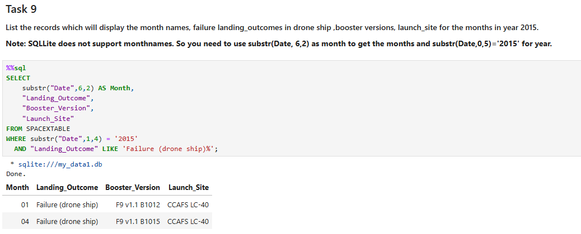
2015 Launch Records
The SQL query filters launch records to include only missions from the year 2015 where the landing outcome was a failed drone ship attempt.
It retrieves the corresponding booster versions and launch site names associated with these failed landings.
The result provides insight into early Falcon 9 recovery attempts and highlights the challenges faced during initial drone ship landing operations.

Slide 33
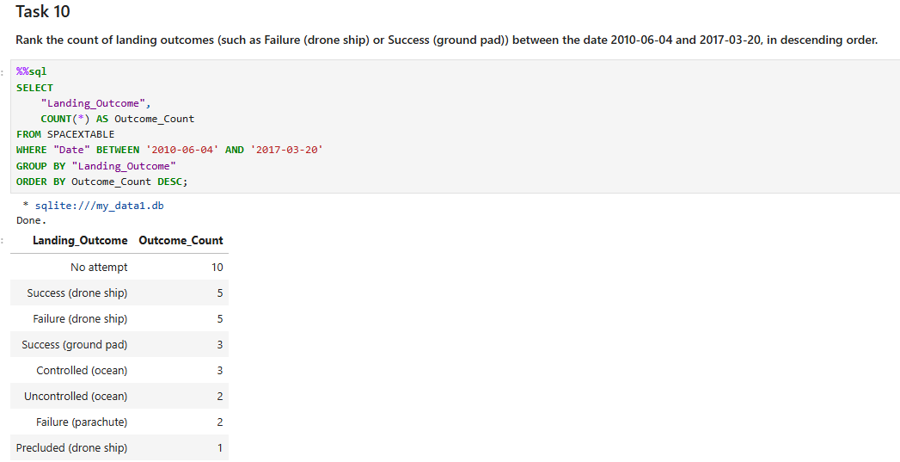
Rank Landing Outcomes Between 2010-06-04 and 2017-03-20
The SQL query filters launch records between June 4, 2010 and March 20, 2017.
It groups missions by landing outcome and counts the number of occurrences for each category.
The results are ordered in descending order to rank landing outcomes by frequency.
This ranking highlights the most common landing results during Falcon 9’s early operational period and shows the progression toward successful recoveries.

Slide 34

Section 3

Slide 35
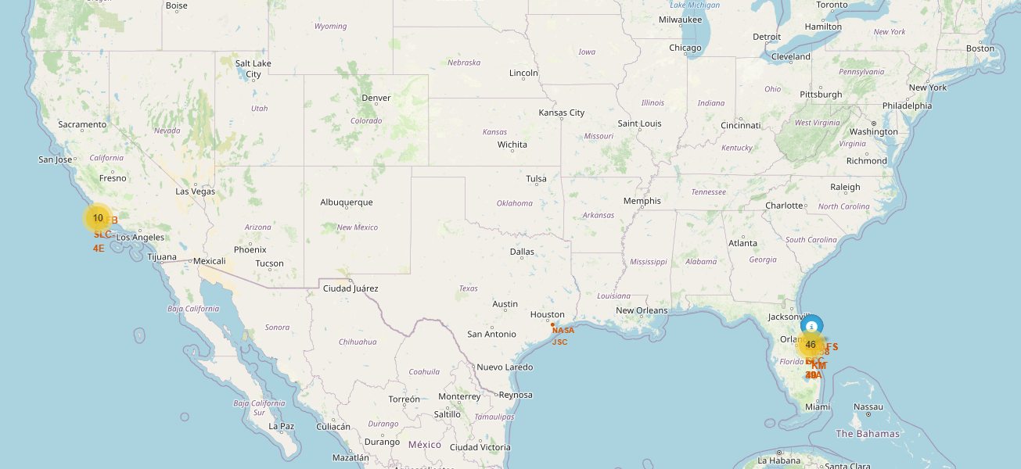
Global Map of SpaceX Launch Sites
The map displays the global locations of SpaceX launch sites.
Most sites are concentrated in the United States and located near coastlines.
This placement supports safe and efficient launch and recovery operations.

Slide 36
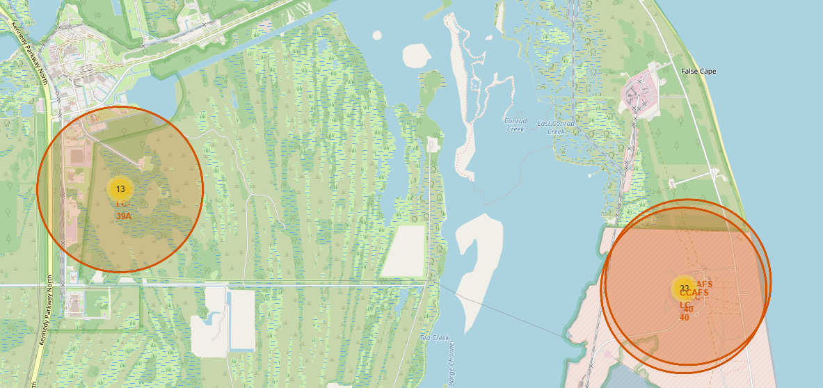
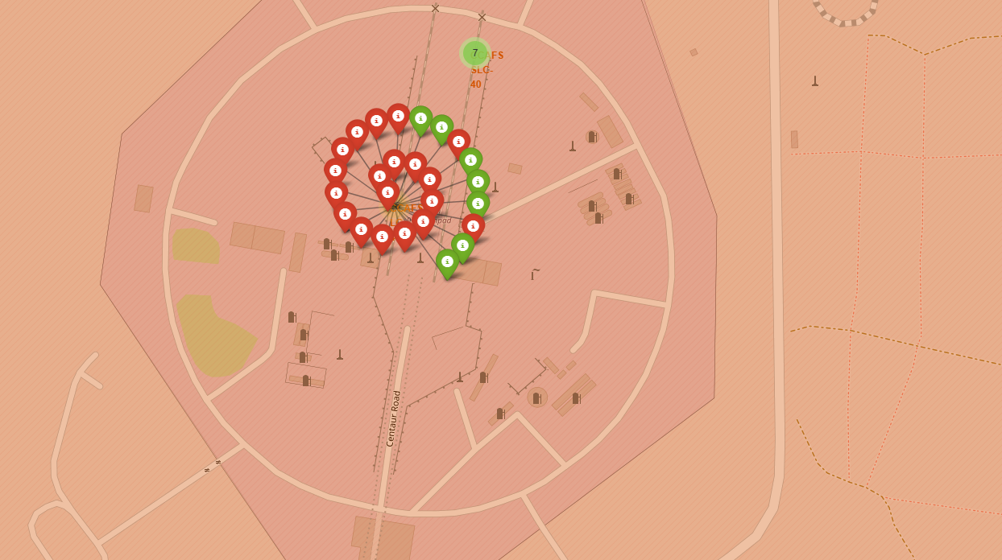
Launch Outcomes at SpaceX sites (Color – Coded)
Displays SpaceX launch sites with markers color-coded by landing outcome
Different colors distinguish successful landings, failures, and no-attempt cases
Most successful recoveries occur at major coastal launch sites
The map makes it easy to compare landing performance across locations

Slide 37
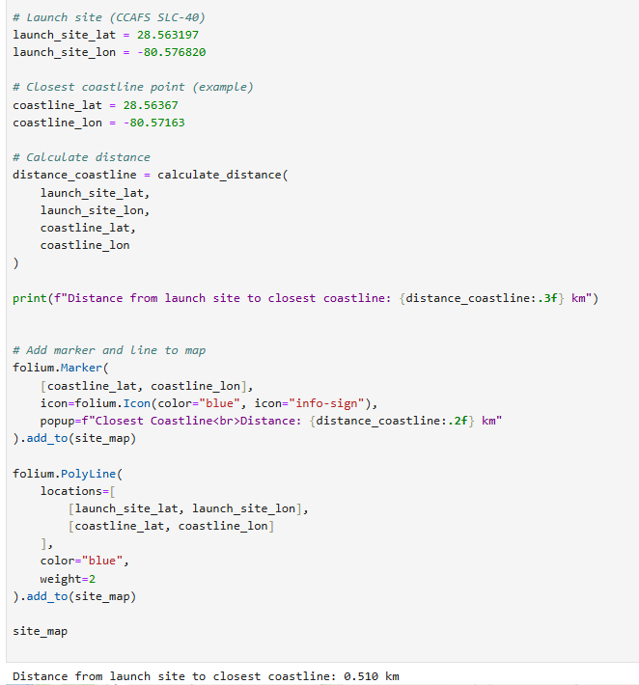
Proximity of SpaceX Launch Site to Key Infrastructure
The map highlights a selected SpaceX launch site and nearby infrastructure.
Lines indicate distances to key features such as the coastline, highways, and railways.
The launch site’s close proximity to the coastline supports safer launch paths over the ocean.
Nearby transport infrastructure improves accessibility and operational logistics.
These factors demonstrate why the site is well-suited for safe and frequent launches.

Slide 38

Section 4

Slide 39
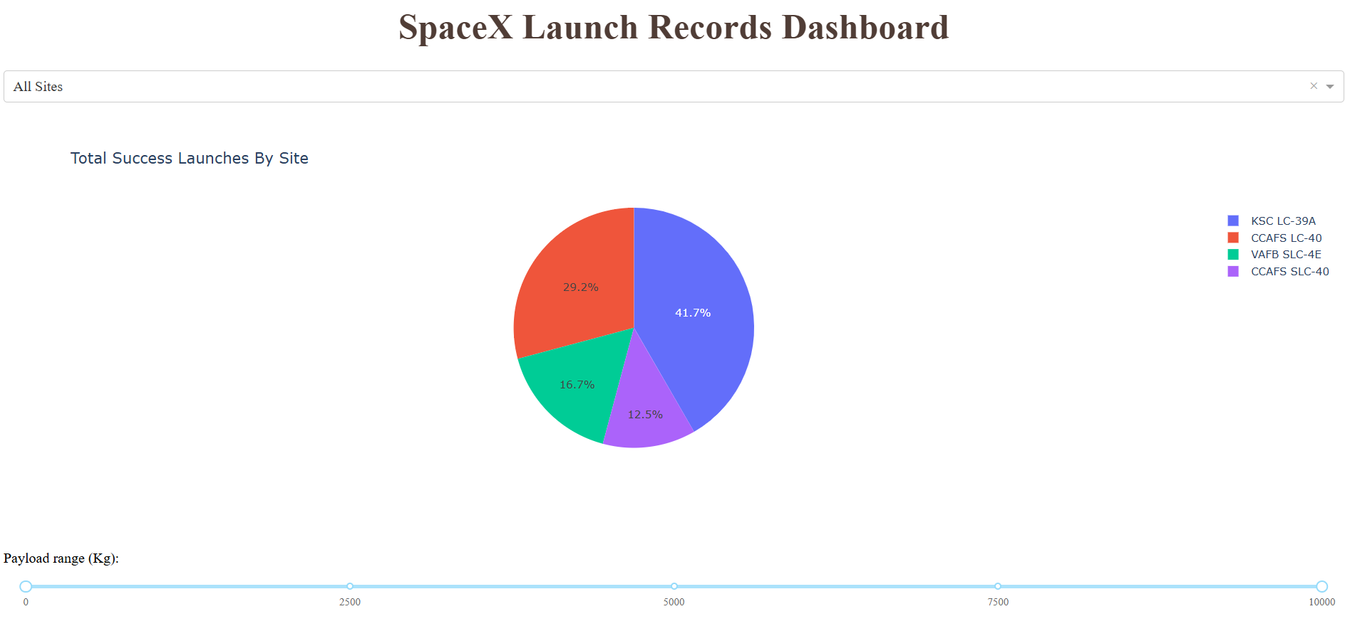
Launch Success Distribution Across SpaceX Launch Sites
The pie chart shows the distribution of successful launches across all SpaceX launch sites.
Each slice represents a launch site’s contribution to the total number of successful launches.
Larger slices indicate sites with higher launch success counts.
The chart highlights which launch sites are most frequently used for successful missions.
This visualization makes it easy to compare launch success performance across sites at a glance.

Slide 40
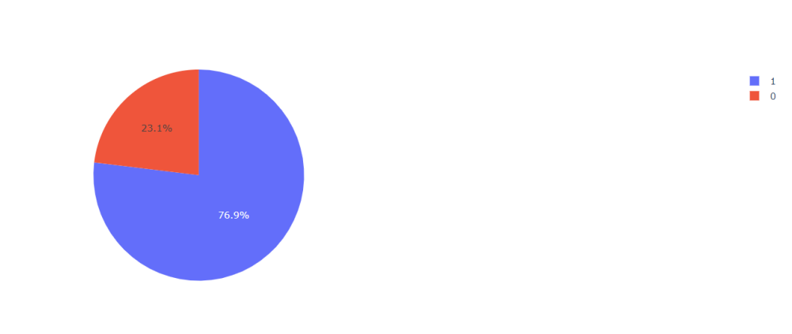
Launch Success Ratio for Highest – Performing SpaceX Launch Site
The pie chart displays the success vs. failure ratio for the launch site with the highest launch success rate.
A dominant success slice indicates a consistently high success performance at this site.
The smaller failure portion highlights minimal unsuccessful launches, reinforcing reliability.
This visualization clearly demonstrates why this launch site outperforms others in terms of mission success efficiency.
The chart makes it easy to compare success probability at a glance and supports data-driven evaluation of launch site performance.
Success Failure

Slide 41
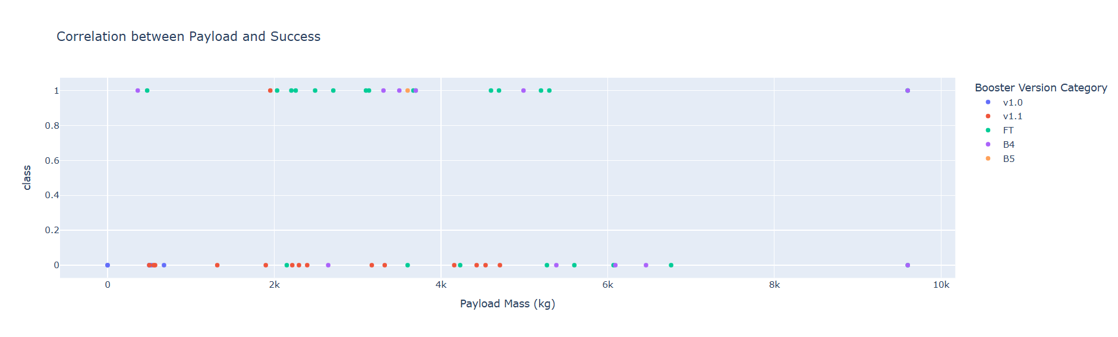
Payload Mass vs. Launch Outcome Across SpaceX Launch Sites
The scatter plot shows the relationship between payload mass (kg) and launch outcome across all SpaceX launch sites.
Each point represents a launch, with outcomes visually separated to distinguish successful and unsuccessful missions.
Using the payload range slider, lower to mid-range payloads show a higher concentration of successful launches.
As payload mass increases, launch outcomes become more mixed, indicating increased mission difficulty at higher payloads.
Certain booster versions demonstrate higher success rates, especially at moderate payload ranges.
This visualization highlights how payload mass and booster technology influence launch success and helps identify optimal operating ranges.

Slide 42

Section 5

Slide 43
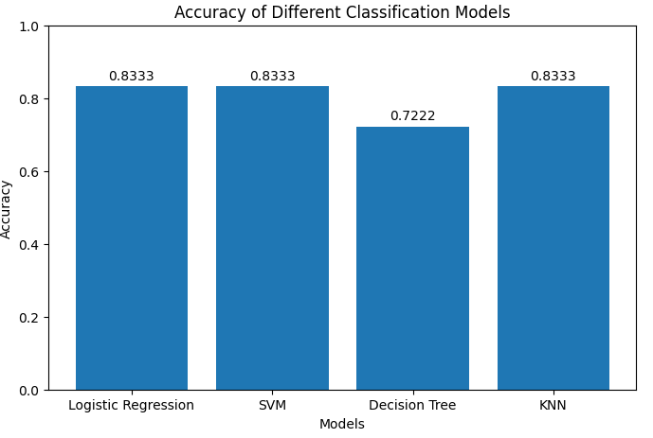
Classification Accuracy
The bar chart compares the classification accuracy of all trained models.
Each bar represents a different algorithm: Logistic Regression, SVM, Decision Tree, and KNN.
Accuracy indicates how well each model predicts launch success outcomes.
Logistic Regression, SVM, and KNN achieved the highest accuracy of 83.33%, indicating similar strong performance.
The Decision Tree model shows lower accuracy (72.22%), suggesting comparatively weaker predictive capability.
Based on these results, Logistic Regression, SVM, and KNN are the best-performing models for this dataset.

Slide 44
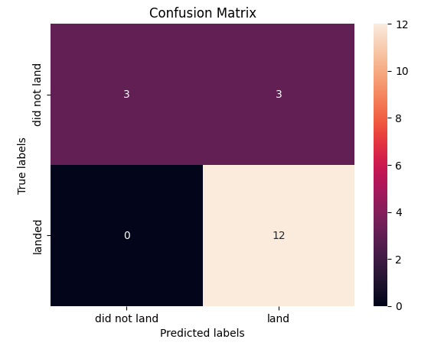
Confusion Matrix
The confusion matrix evaluates the performance of the best-performing classification model by comparing predicted launch outcomes with actual outcomes.
True Positives (12) indicate successful launches correctly predicted as successful.
True Negatives (3) represent failed launches correctly predicted as failures.
False Positives (3) show failed launches incorrectly predicted as successful.
False Negatives (0) indicate no successful launches were misclassified as failures.
The dominance of correct predictions along the diagonal demonstrates strong model performance.
The absence of false negatives highlights the model’s effectiveness in identifying successful launches.
Overall, the confusion matrix confirms the model’s reliability for predicting SpaceX launch success.

Slide 45
Conclusions
Exploratory analysis shows that launch success varies by launch site, with certain sites consistently achieving higher success rates.
Payload mass influences launch outcomes, with lower to mid-range payloads exhibiting higher success probabilities.
Logistic Regression, SVM, and KNN achieved the highest classification accuracy (~83%), outperforming the Decision Tree model.
The confusion matrix confirms strong predictive performance, showing no false negatives and a high number of correct predictions.
Overall, machine learning models effectively predict SpaceX launch success and support data-driven decision-making.

Slide 46
Appendix
Code (Python, SQL)
Dash & Folium outputs
ML training & evaluation artifacts
Processed datasets

Slide 47


